Slide 1
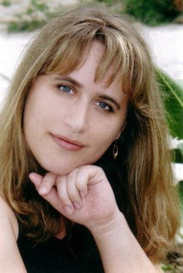
Teaching Background
Experience: 19 years
Responsibilities: school Resource Center materials developer
Head teacher and ELT instructor
All-Ukrainian Olympiad , Kherson city jury member (annually)
Independent External Evaluation Board member (2014)
EDUCATION Kherson State Pedagogical Institute (1995)
PROFESSIONAL DEVELOPMENT
Intel - Education for Future (2005)
TEA program Alumni (6 weeks PD program at University of Nebraska,, Lincoln, USA (2009)
TEACHER TRAINER (08/2010-present)
British Council IATEFL Summer School
Train the Trainer (2013) & Follow up (2014)
Workshops conducted:
Web-quest technology in teaching English
Interactive tools in teaching English
New trends in TEFL
Insett Components: Reading, Vocabulary, Listening
Surname: Yerokhina
Name: Oksana
Place of work: Kherson Classic School #3 (08/1995-present)
Position: teacher of English (grades 5-11)

